Slide 1

CoderDojo Bray
Introduction to Programming
Sessions 1-6: Scratch

Slide 2
This Week
Keep working on your project!
Show your project to a mentor to earn your
FREE GOODIE BAG!
Share your projects on the web at http://scratch.mit.edu
Take a break for a few minutes at 3.30

Slide 3
Use the online materials
http://goo.gl/zn4XC
Contains all the handouts from previous weeks
http://resources.scratchr.org/

Slide 4
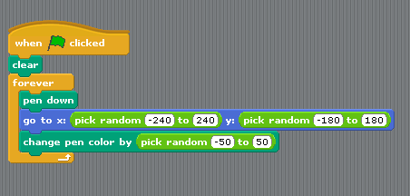
From Scratch to “real code”
An “event”; like “on click”
Pen down; Go to;
like “lineTo(0, length)” or
“fillRect ()”
Pick random; like “math.random()”
Change colour; like "rgb()”
A “loop”; like “while (something) then (do something)”

Slide 5
After the break – a Bug -off!
On JS Fiddle:
Star: http://jsfiddle.net/earnubs/TZasK/
The star is too small – make it bigger
Make it blue inside
Colours: http://jsfiddle.net/newpatriks/5VcQL/
The flashing is too frequent – make it slower
Make the squares bigger

Slide 6
What next – show of hands
What would you like to work on in future sessions?
More Scratch
HTML5 games
App Inventor for Android
Another language?
Team projects
Hardware and software working together
Something else (say what)

Slide 7
What next?
More about HTML5:
http://techslides.com/learning-html5-canvas-through-jsfiddle-examples/
Get your teacher to register for the Scratch competition here:
http://www.ics.ie/scratch/index

